Slide 1
Linux网络体系结构

Slide 2
Applications, Tools
User space
System calls
Linux-Kernel
Process
management
Memory
management
File
systems
Device
drivers
Network
Components
Virtual
Files,
Device access,
Network
Functionality
Multitasking
memory
directories
terminals
Functionality
Scheduler,
Architecture-
specific
code
Memory
manager
File system
types
Character
devices
Network
protocols
Software
Support
Block devices
Network
drivers
Hardware
Support
CPU
RAM
Hard disk,
CD, Floppy
disk
Various
Terminal
equipment
Network
adapter
Hardware
Figure 2-1. Structure of the Linux kernel according to [RuCo01].

Slide 3
Functionality | Functions for Dynamic Registration
Character devices | (un)register_chrdev( )
Block devices | (un)register_blkdev( )
Binary formats | (un)register_binfmt( )
File systems | (un)register_filesystem( )
Serial interfaces | (un)register_serial( )
Network adapters | (un)register_netdev( )
Layer-3 protocols | dev_add_pack( ), dev_remove_pack( )
Layer-4 protocols (TCP/IP) | inet_add_protocol( ), inet_del_protocol( )
Console drivers | tty_(un)register_driver( )
Symbol tables | (un)register_symtab( )
Modules | init_module( ), cleanup_module( )
Table 2-1. Interfaces in the Linux kernel to embed new functionalities.

Slide 4
Device Drivers
In UNIX, physical devices are hidden from the user and accessible only over the file system.
Device drivers in the form of modules can be added or removed in Linux at any time.
Device number:
The major number identifies the driver of a device.
The minor number is used to distinguish different devices used by the same driver
Linux differs between two types of physical devices
Block-oriented devices: A block-oriented driver can be registered with the kernel function register_blkdev(). If the function was completed successfully, then the driver can be addressed by the returned major number.
Character-oriented devices: normally accessed in sequential order; use register_chrdev() to register
The command mknod /dev/name typ major minor : used to create an entry an entry in the /dev directory

Slide 5
struct file_operations
{
struct module *owner;
int (*lssek) (file, offset, origin);
int (*read) (file, buffer, count, pos);
int (*write) (file, buffer, count, pos);
int (*readdir) (file, dir);
int (*poll) (file, poll_table);
int (*ioctl) (inode, file, cmd, unsigned arg);
...
int (*open) (inode, file);
int (*release) (inode, file);
...
}
Figure 2-8. File operations on a device driver.

Slide 6
Device Drivers
A driver is addressed over a virtual file in UNIX
owner refers to the module implemented by the driver (for a module-based driver);
lseek() sets the position pointer in a file.
read() transfers data from the driver to the user address space.
write() is used to transfer data from the user address space to the kernel address space
ioctl() is used to set certain parameters of a driver or device.
open() and close() are used to prepare (or postedit) a driver for subsequent (or completed) commands.

Slide 7
sk_buff_head
sk_buff
next
sk_buff
prev
list
stamp
net_device
dev
h
nh
mac
Packet data storage
dst
len
MAC header
…
IP header
head
UDP header
data
UDP data
tail
end
datarefp: 1
Figure 4-1. Structure of socket buffers (struct sk_buff) with packet storage locations

Slide 8

higher protocol instances
Network device
netif_rx
dev_queue_xmit
dev_open
dev_close
(adapter-independent)
Network-devices
interface
dev->hard_start_xmit
dev->open
dev->stop
Abstraction from
adapter specifics
net_rx
net_tx
net_start_xmit
net_stop
Network driver
skb
skb
net_open
(adapter-specific)
net_interrupt
skb
Figure 5-1. The structure of a network device interface.

Slide 9
net_device
dev_base
name: eth1
state
next
net_device
priv
…
Hardware
net_device
MAC layer
Local2
private driver structure
name: eth0
state
Network layer
next
priv
adapter_open()
open
adapter_stop()
…
stop
Hardware
adapter_satrt_xmit()
hard_start_xmit
…
MAC layer
Network layer
adapter_open()
open
adapter_stop()
stop
adapter_satrt_xmit()
hard_start_xmit
…
Local1
private driver structure
Figure 5-3. Linking net_device structures.

Slide 10
dev.c
netif_rx
driver.c
net_tx
net_rx
net_error
Receiving a packet
Completing
a transmission process
Error situation
net_interrupt
Figure 5-5. A network adapter uses an interrupt to send messages.

Slide 11
Application processes
Layer 5
NET_RX_SOFTIRQ
Software interrupt
System calls
* Kernel activities
(interrupts, tasklets, timer handlers, etc.)
*
Layer 1-4
CPU1
CPU2
eth0
eth1
Hardware interrupt
Net_RX-
Soft-IRQ
System
calls
Net_TX-
Soft-IRQ
Figure 6-2. Activity forms in the Linux network architecture.

Slide 12
Layer 3
arp_rcv
ip_rcv
..
p8022_rcv
arp_send
…
ip_queue_xmit
dev.c
ETH_P_802_2
br_input.c
dev.c
net_rx_action
handle_bridge
dev_queue_xmit
CONFIG_BRIDGE
dev->qdisc->
enqueue
do_softirq
Scheduler
eth0
eth1
CPU1
CPU2
dev.c
qdisc_run
net_tx_action
softnet_data[cpu_{n}].input_pkt_queue
data-link layer (OSI layer 1+2)
dev.c
netif_rx
netif_rx
qdisc_restart
Scheduler
driver.c
eth_type_trans()
dev->qdisc->dequeue
dev_alloc_skb()
net_interrupt
driver.c
dev->hard_start_xmit
Figure 6-3. The path of a packet in the data-link layer of the Linux kernel.

Slide 13
dev.c, net/sched/*
dev_queue_xmit
softirq.c, netdevice.h
dev->qdisc->enqueue
Timer
timer_handler
netif_schedule
cpu_raise_softirq
Scheduler
NET_TX_SOFTIRQ
qdisc_run
net_tx_action
do_softirq
qdisc_restart
dev->qdisc->dequeue
driver.c
dev->hard_start_xmit
Figure 6-4. The process involved when sending a packet by dev_queue_xmit().

Slide 14
0
packet_type
ptype_base[16]
type:ETH_P_ARP
dev: NULL
arp_rcv()
func
data:1
packet_type
next
1
type:ETH_P_IP
dev: NULL
ip_rcv()
func
data: 1
next
…
16
packet_type
packet_type
packet_type
ptype_all
type:ETH_P_ALL
type:ETH_P_ALL
dev
dev
func
func
data
data
next
next
Figure 6-5. Managing protocols above network devices.

Slide 15
Higher layers
ip_input.c
ip_output.c
ip_queue_xmit
ip_local_deliver
MULTICAST
ip_mr_input
IP_LOCAL_OUTPUT
IP_LOCAL_INPUT
ip_forward.c
ip_queue_xmit2
IP_FORWARD
ip_local_deliver
ip_forward
ip_forward_finish
ip_output
ROUTING
ip_finish_output
ip_rcv_finish
ip_fragment
Forwarding
Information Base
IP_PRE_ROUTING
IP_POST_ROUTING
ip_rcv
ip_route_input
ARP
ip_finish_output2
neigh_resolve_
output
dev.c
dev.c
net_rx_action
dev_queue_xmit
Figure 14-4. Architecture of the Internet Protocol implementation in Linux.
Notes:
ip_rcv协议收到数据后识别地址 若是自己的则传至ip_local_deliver 否则传至ip_route_input

Slide 16
0
inet_protocol
inet_protos[MAX_INET_PROTOS]
handler
udp_rcv()
err_handler
udp_err()
next
inet_protocol
protocol:IPPROTO_UDP
copy
data
name:“UDP”
1
inet_protocol
handler
igmp_rcv()
err_handler
Null
next
protocol:IPPROTO_IGMP
copy
data
name:“IGMP”
MAX_INET_
PROTOS
inet_protocol
Figure 14-5. Hash table used to multiplex transport protocols.

Slide 17
net_device
dev_base
name:eth1
…
net_device
Network layer
name:eth0
ip_ptr
in_device
state
…
next
…
in_ifaddr
Hardware
in_device
MAC layer
ip_mc_list
Network layer
dev
ip_ptr
refcnt
…
lock
dead
in_ifaddr
in_ifaddr
ifa_list
mc_list
ip_mc_list
mr_v1_seen
arp_parms
ip_mc_list
…
cnf
ipv4_devconf
neigh_parms
Figure 14-8. Data structures to manage IP network devices and their parameters.

Slide 18
sk->data_ready
send
TCP
tcp_data_queue
tcp_ack
snd_check
tcp_sendmsg
Retrans.
Timer
Fast Path
tcp_send_
(delayed)_ack
tcp_data
tcp_send_skb
tcp_data_
snd_check
Section 24.3
Slow Path
Pure
ACK
tcp_write_
timer
tcp_rcv_
state_process
tcp_rcv_
established
tcp_ack
TCP_ESTABLISHED
tcp_re-
transmit_skb
tcp_v4_do_rcv
__tcp_v4_lookup( )
tcp_write_
xmit
tcp_transmit_skb
tcp_v4_rcv
ip_input.c
ip_output.c
ip_local_deliver
ip_queue_xmit
Figure 24-2. Partial representation of how packets are handled in the TCP instance.

Slide 19
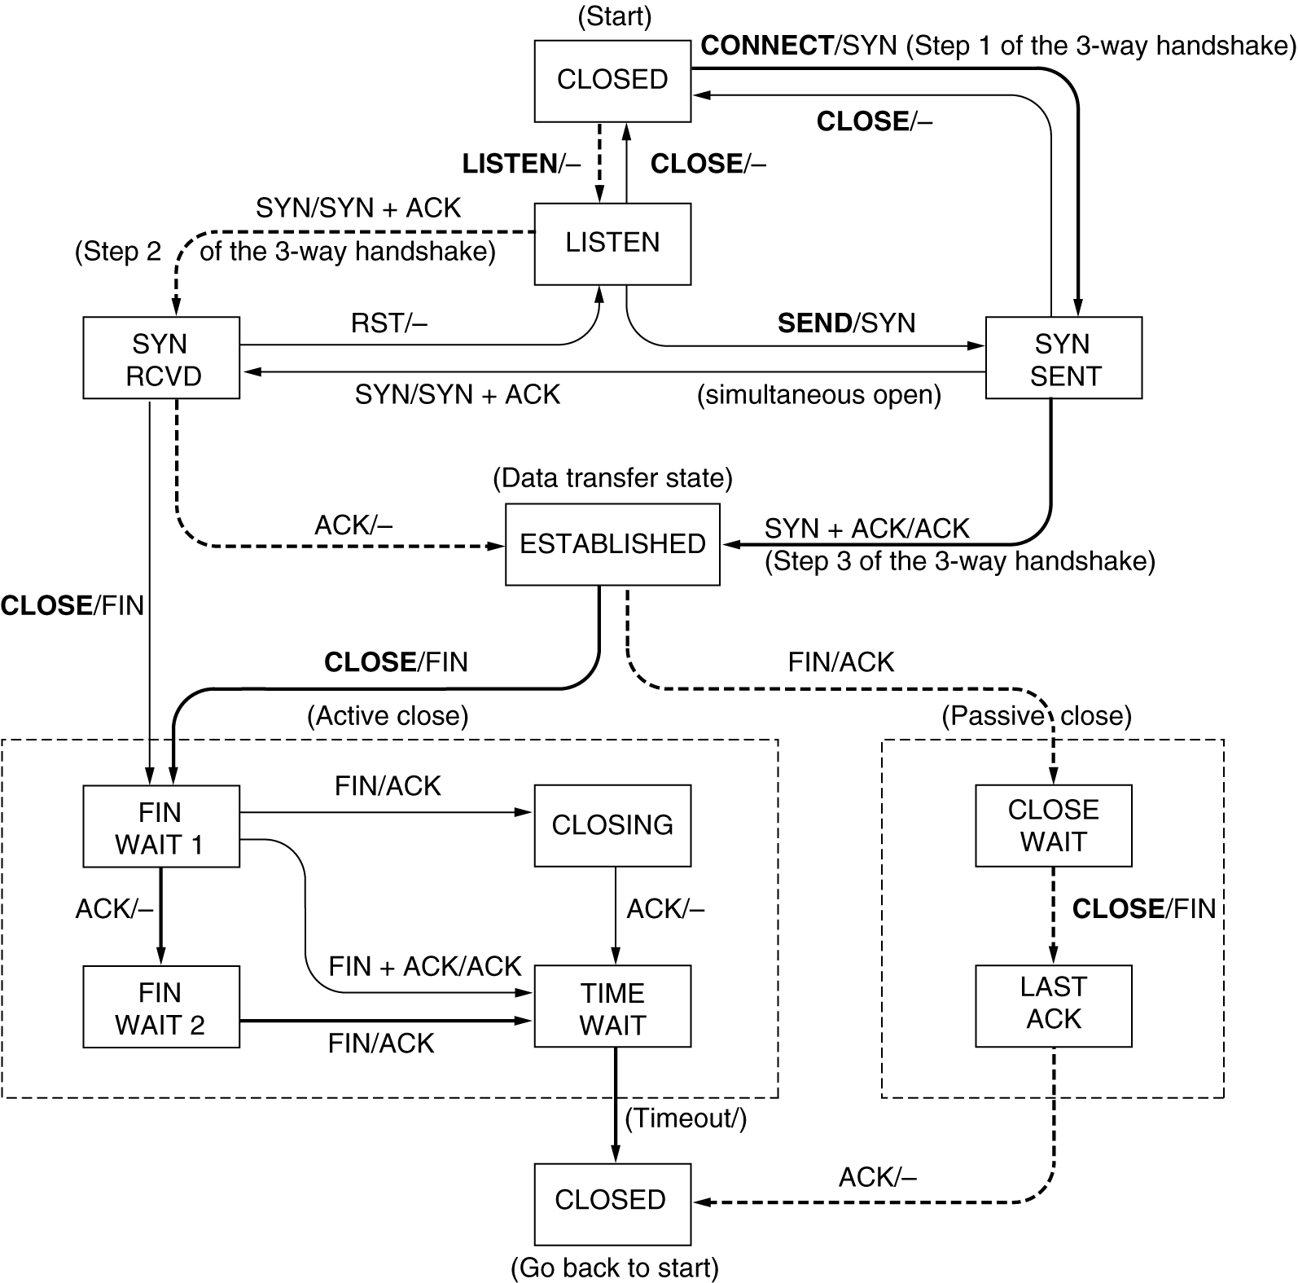
The heavy solid line is the normal path for a client. The heavy dashed line is the normal path for a server. The light lines are unusual events. Each transition is labeled by the event causing it and the action resulting from it, separated by a slash.
TCP connection management finite state machine.

